Slide 1
midterm project I
predicting flight delays
Ryan Campbell, Timothy Lau, Renée Hall February 12, 2021

Slide 2
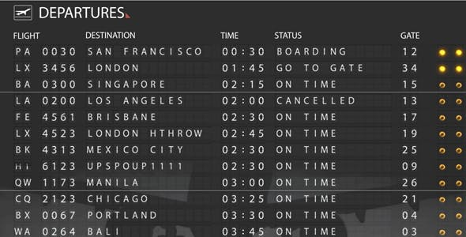

Slide 3
Approach
Data Wrangling
Pull data from database
Handle missing values
Create sample for modelling.
1
Data Exploration & Feature Creation
Find relationships between independent and dependent variables. Build features to help represent these relationships in the test data.
2

Slide 4
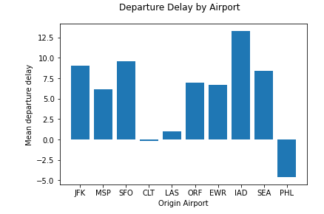
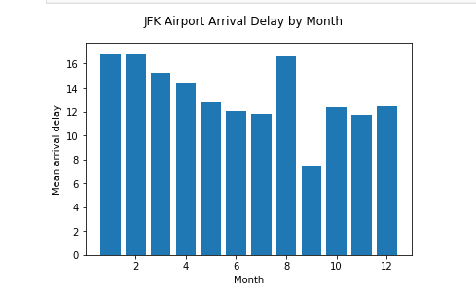

Slide 5
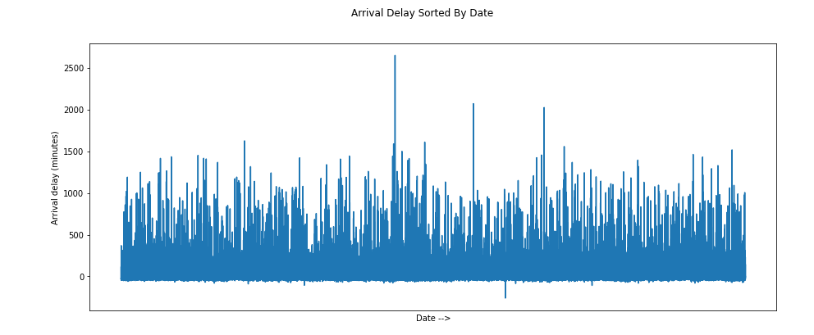

Slide 6
Approach
Classifier
XGBoost Classifier to predict whether a flight will be delayed or not.
3

Slide 7
Approach
Regressor
XGBoost Regressor to predict delay or no delay, then use a regression model to predict delay length.
4
Classifier
XGBoost Classifier to predict whether a flight will be delayed or not.
3

Slide 8

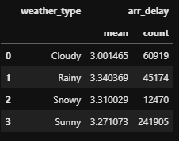
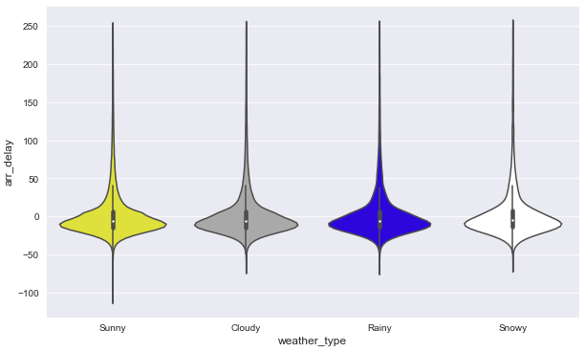
World Weather API
Python wrapper API Library super helpful
Got 2018-2019 weather for all airports 👍
Used:
Sunny, Cloudy, Rainy, Snowy
Snow (cm)
Precip (mm)
Sun Hour
Cloud Cover
Weather tended to “average out”
More granular binning may help

Slide 9
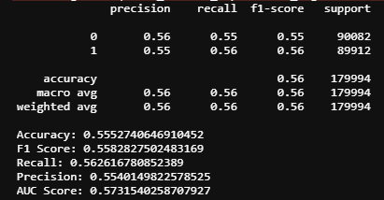
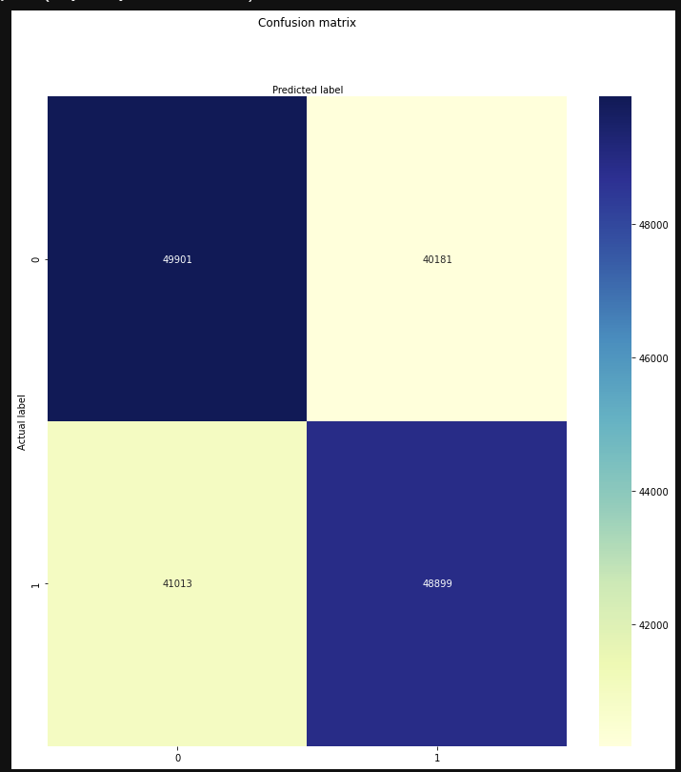
Modelling - Classifier
Started with base models
Tried many types (Linear, Ridge, Lasso, Logistic, Naive Bayes, RF, XGB)
XGB best, RF 2nd best
Iterated with base and engineered features in models
Challenge: Including new features threw off balance of classifier (Ex: overpredict delays)
End of Day: Lots of effort for small gains on a marginal (but at least balanced) classifier
Win: Shared google excel for tracking model runs

Slide 10
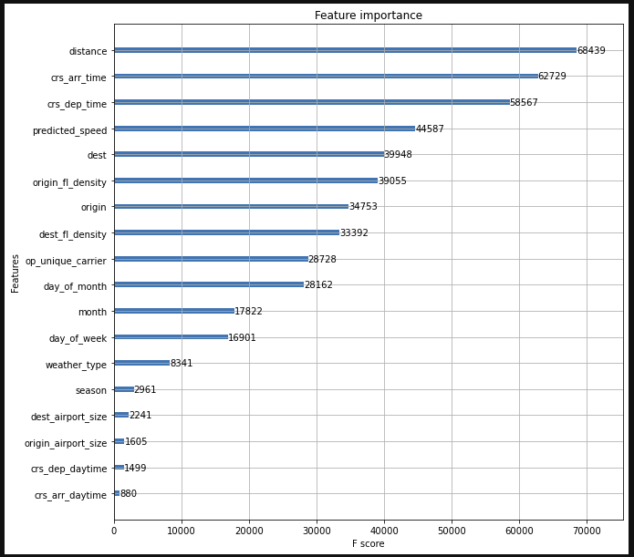
Modelling - Feature Importance
Engineered many features
Many iterations adding and dropping features
Tree-based (XGB and RF) feature importance really helped narrow down the list
Also did logistic feature importance

Slide 11
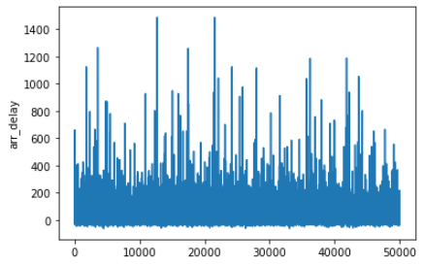
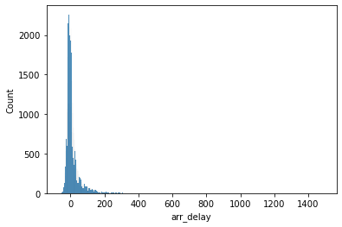
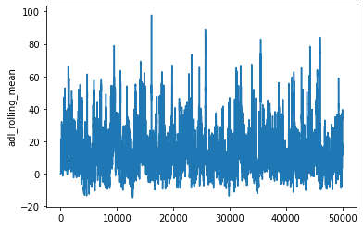
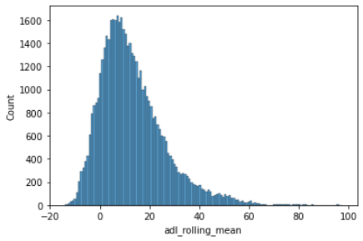
Regression
Used rolling mean on arr_delay
Used many features brought by feature importance from classification
Ended up using tree based XGBR
SelectFromModel

Slide 12
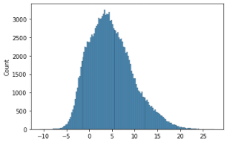
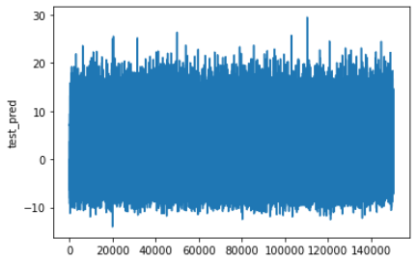
Predictions
Predictions for rolling mean of arr_delay

Slide 13
challenges
Working in parallel with coding, data coordination, and iterations amongst 3 team members

